Slide 1


Slide 3
A
B
C
D
Data Loading
Data Analysis
And
Preprocessing
Model
Training
And
Testing
Methodology
We start by importing the essential libraries like NumPy and Pandas, required for loading the dataset.
Data preprocessing ensures clean, organized data by handling missing values, outliers, encoding categories, and scaling features for effective model training.
A stacking algorithm from ensemble learning was implemented, combining predictions from multiple base models to enhance overall accuracy and performance
The dataset was split into training and testing sets to train the model and evaluate its performance, ensuring reliable and robust predictions.
Steps

Slide 4
A
B
C
D
Data Loading
Data Analysis
And
Preprocessing
Model
Training
And
Testing
Methodology
We start by importing the essential libraries like NumPy and Pandas, required for loading the dataset.
Data preprocessing ensures clean, organized data by handling missing values, outliers, encoding categories, and scaling features for effective model training.
A stacking algorithm from ensemble learning was implemented, combining predictions from multiple base models to enhance overall accuracy and performance
The dataset was split into training and testing sets to train the model and evaluate its performance, ensuring reliable and robust predictions.
Steps

Slide 5
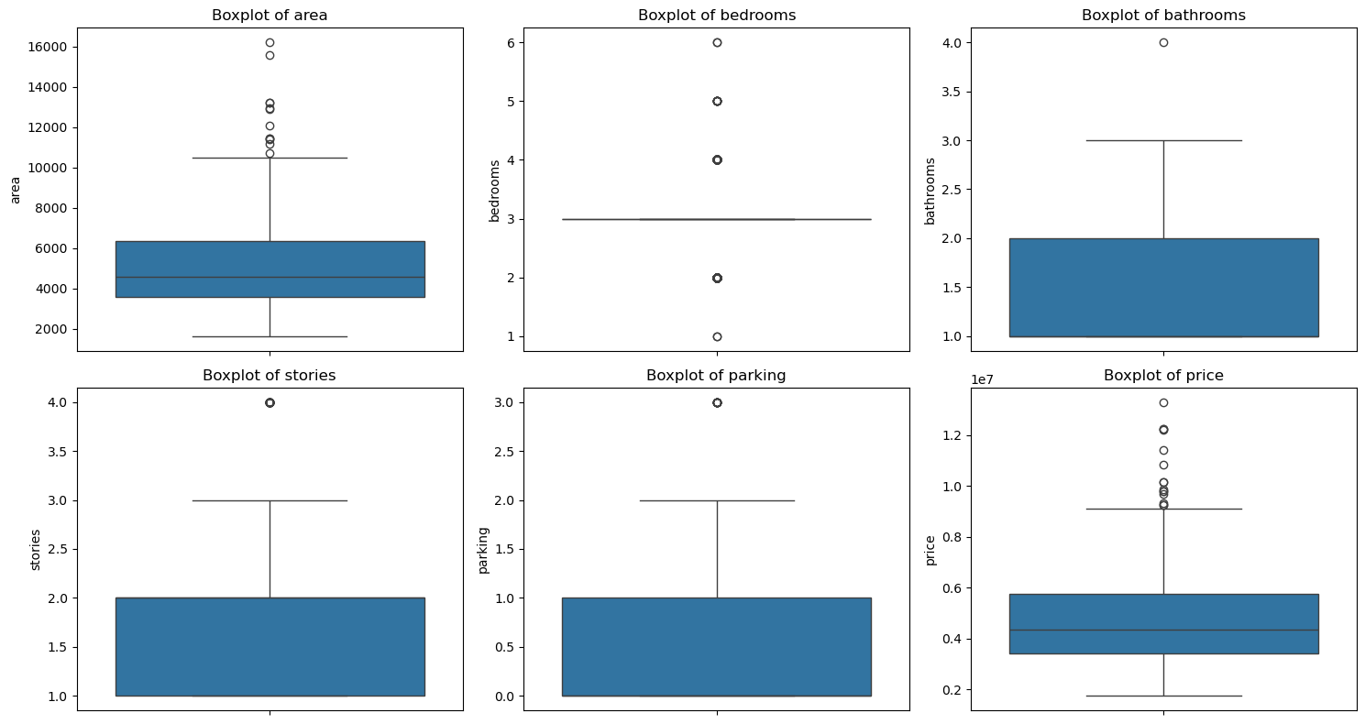
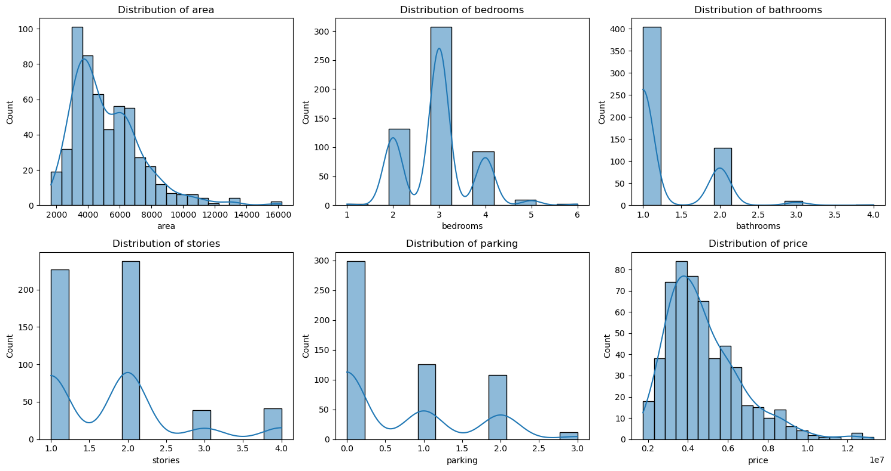
Data Analysis and Preprocessing
Box plots are graphical representations that summarize the distribution of dataset, highlighting the median, quartiles, and potential outliers. They provide a quick visual insight into data spread and variability.
Distribution plots visual representation of the distribution of a dataset. It helps to understand key characteristics like central tendencies, spread of data, shape of data and identify any patterns formed in the dataset.

Slide 6
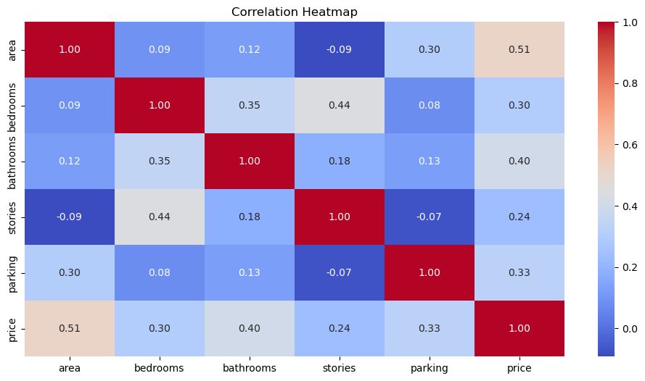
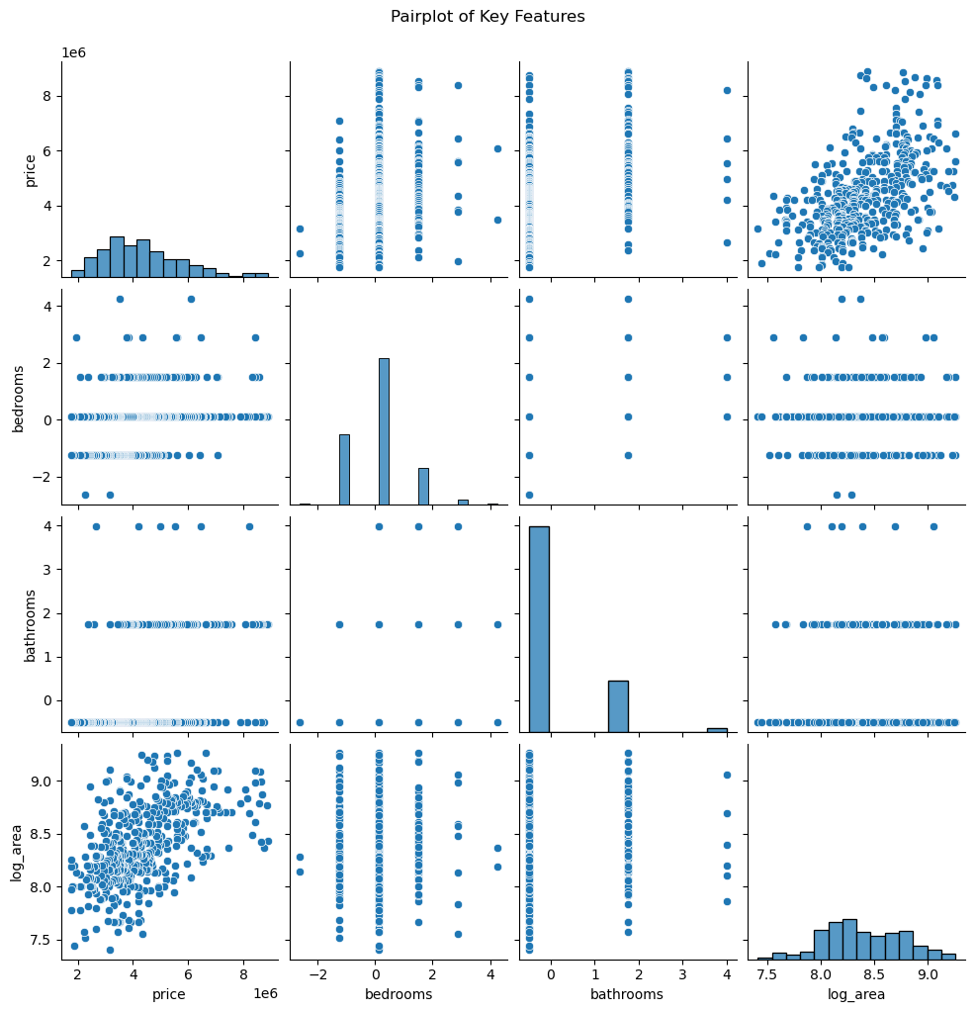
Data Analysis and Preprocessing
Heatmap is a visual representation of data where values are represented by colours. It helps identify potential multicollinearity issues and informs feature selection decisions.
Pair plots visualize relationships between multiple variables in a dataset by creating a matrix of scatterplots and histograms. It helps to reveal linear, non-linear, or no relationships between pairs of variables.

Slide 7
Stacking Model
Base Model
Final Estimator
Random Forest
Regressor
Gradient Boost
Regressor
XGBoost
Regressor
Linear Regression
The Random Forest Regressor is an ensemble learning method that uses multiple decision trees to improve prediction accuracy and control overfitting. It performs well for both linear and non-linear relationships.
Gradient Boost Regressor is a boosting technique that builds models sequentially, where each model corrects the error of its predecessor. This method is particularly effective for capturing complex patterns.
The XGBoost Regressor is an advanced and efficient implementation of gradient boosting. It focuses on speed and accuracy by leveraging techniques like regularization, parallel processing.
Linear Regression is a simple and interpretable regression technique that models relationship between a dependent variable and one or more independent variables as a straight line. It works well for simple data.

Slide 8
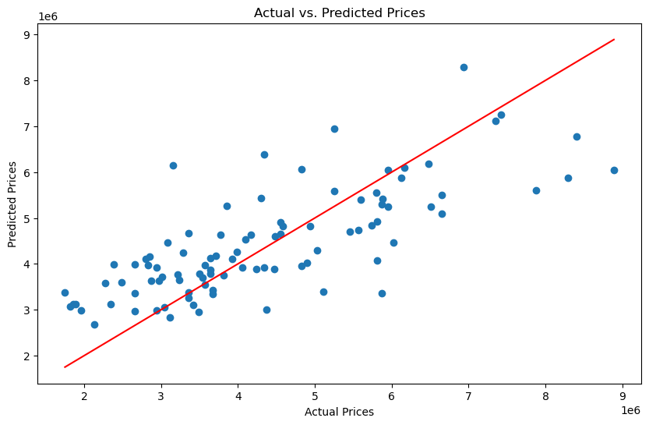
Result
And Discussion
Scatter plots of predictions versus actual values were generated, showing the correlation between the dependent and independent variables. The line of best fit indicates the model's ability to capture the relationship in the data.

Slide 9
Result
And Discussion
Advancements can enhance the model's accuracy and precision. Incorporating advanced engineering and introducing new data features can significantly improve forecasting performance.
Exploring more complex models like Decision Trees or Polynomial Regression, and comparing their performance through rigorous training and testing, can help identify the most effective approach.
Using additional metrics such as Root Mean Squared Error (RMSE) and implementing regularized linear regression techniques like Ridge or Lasso can address overfitting and provide more comprehensive evaluations.

Slide 10
THE END

